Slide 1
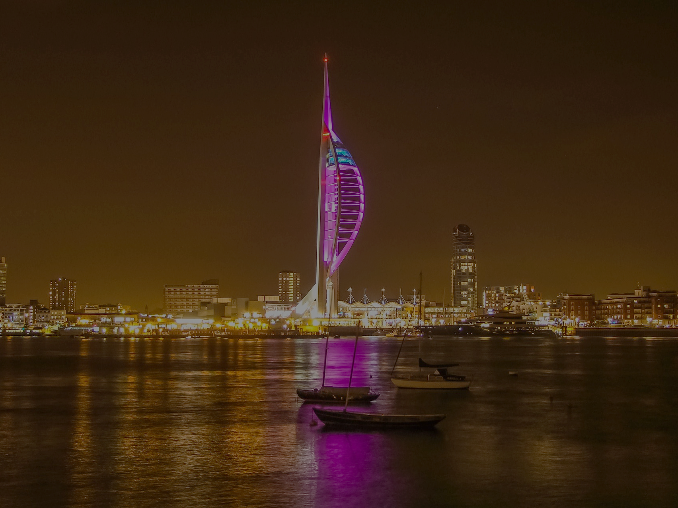
ANNUAL SCIENTIFIC MEETING
Village Hotel, Portsmouth
Friday 24th November 2023
Confirmed speakers:
Dr Jeremy Campbell
Dr Matthew Coleman
Mr Andrew Durnford
Miss Laura Fulwell-Smith
Donna Ockenden
Mrs Susanna Stanford
Dr Lawrence Tsen
Neuraxial ultrasound workshops
Consultants £125 | SAS/Trainees/Fellows £100 | Midwives/ODPs/Anaesthetic practitioners £50
£25 ‘Early Bird’ discount available, closes 31st July 2023 – use code EARLY25
Bookings/abstract submissions for oral presentation or poster via WOA website: www.woagroup.org.uk/woa-asm
Abstract submissions close Fri 22nd September 2023

